Slide 1
CSC 473 – Automatic plant watering system
A final presentation
By: Zach Wilson, Mathew Brown
& Thomas Moskal

Slide 2
The Predicament
The Solution
Got house plants but you’re;
Absent-minded?
Have a busy schedule?
Going on vacation?
or, Just plain lazy?
An independent watering system that monitors soil humidity levels in order to give a plant the perfect amount of water at just the right time. With no fuss on your end!

Slide 3
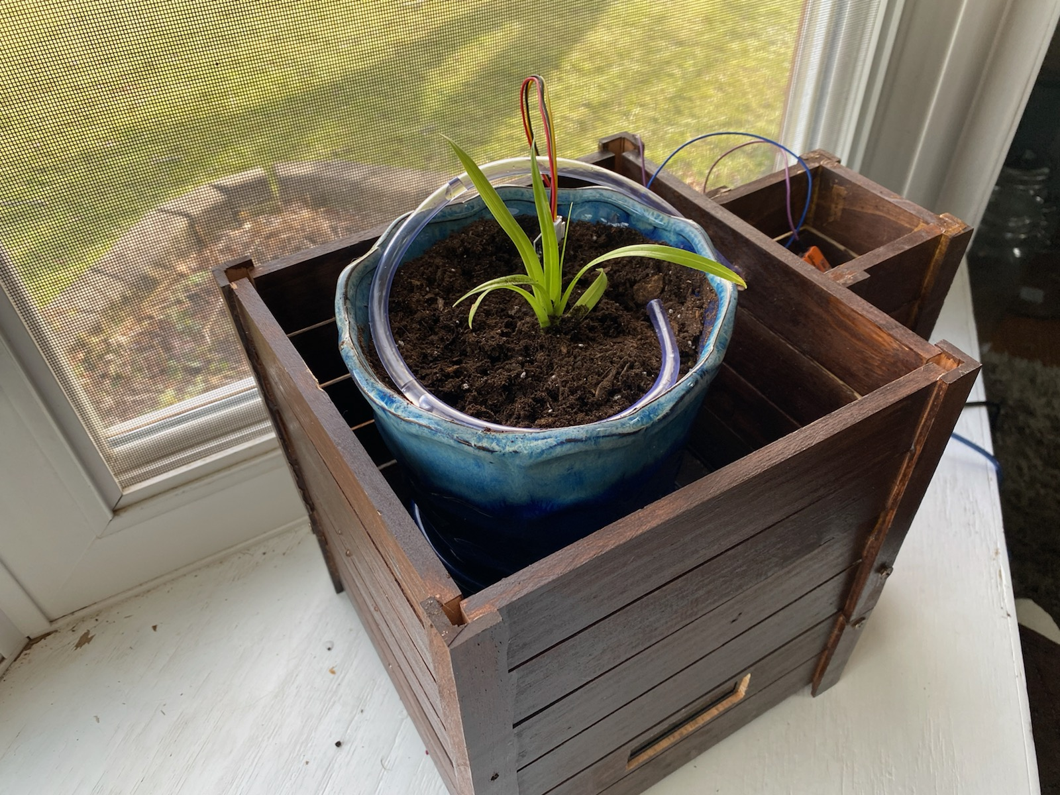
The automatic watering plant system!

Slide 4
Project goals
We planned to create a system that is effective, cleanly built, aesthetically pleasing and mostly independent. The completed system should require no maintenance, apart from occasionally refilling a water receptable.
It will come with its own wooden enclosure capable of holding a large variety of house plants.
Components of the project will be discreetly placed but fully functional with little to no interaction needed on the user's part.

Slide 5
Components used
Arduino Uno microcontroller
5-volt relay
Liquid Crystal Display (LCD)
Water container
F-M, M-M and F-F 20-gauge wires
Small breadboard
One masterfully crafted wooden enclosure with water holder and bottom compartment
Water tubing
Standard house plant
Potentiometer
220-ohm resistor

Slide 6
Components used
5-volt water pump
Wago^{tm} wire splicers/connectors
12-volt external power supply
Soil humidity level sensor
Others…
Other components involve power tools used to design and create the wooden enclosure.

Slide 7
Progress blockers
We originally began with a 12v relay and water pump. These proved to be bad quality and we had to purchase from a different vendor.
The String class for Arduino would use too much memory, this would result in the plant either not watering when needed or, the pump would continue running even when it should have turned off.
The new water pump had to fit inside of the water container, so we had to find a new container that would fit the pump and an adequate amount of water.

Slide 8
Progress blockers
When using the soil sensor, we learned that soil composition is important to the consistency of the readings. If we used a medium that wasn’t a common soil composition, we would receive very different and sometimes unusable readings.
The quality of soil sensor we purchased was low and we would recommend better ones for other projects. However, that led to the discovery that only giving power to the sensor when doing a reading was ideal to decreasing the amount of corrosion the sensors take over a long period of time.

Slide 9
Enclosure & Components
Enclosure

Slide 10
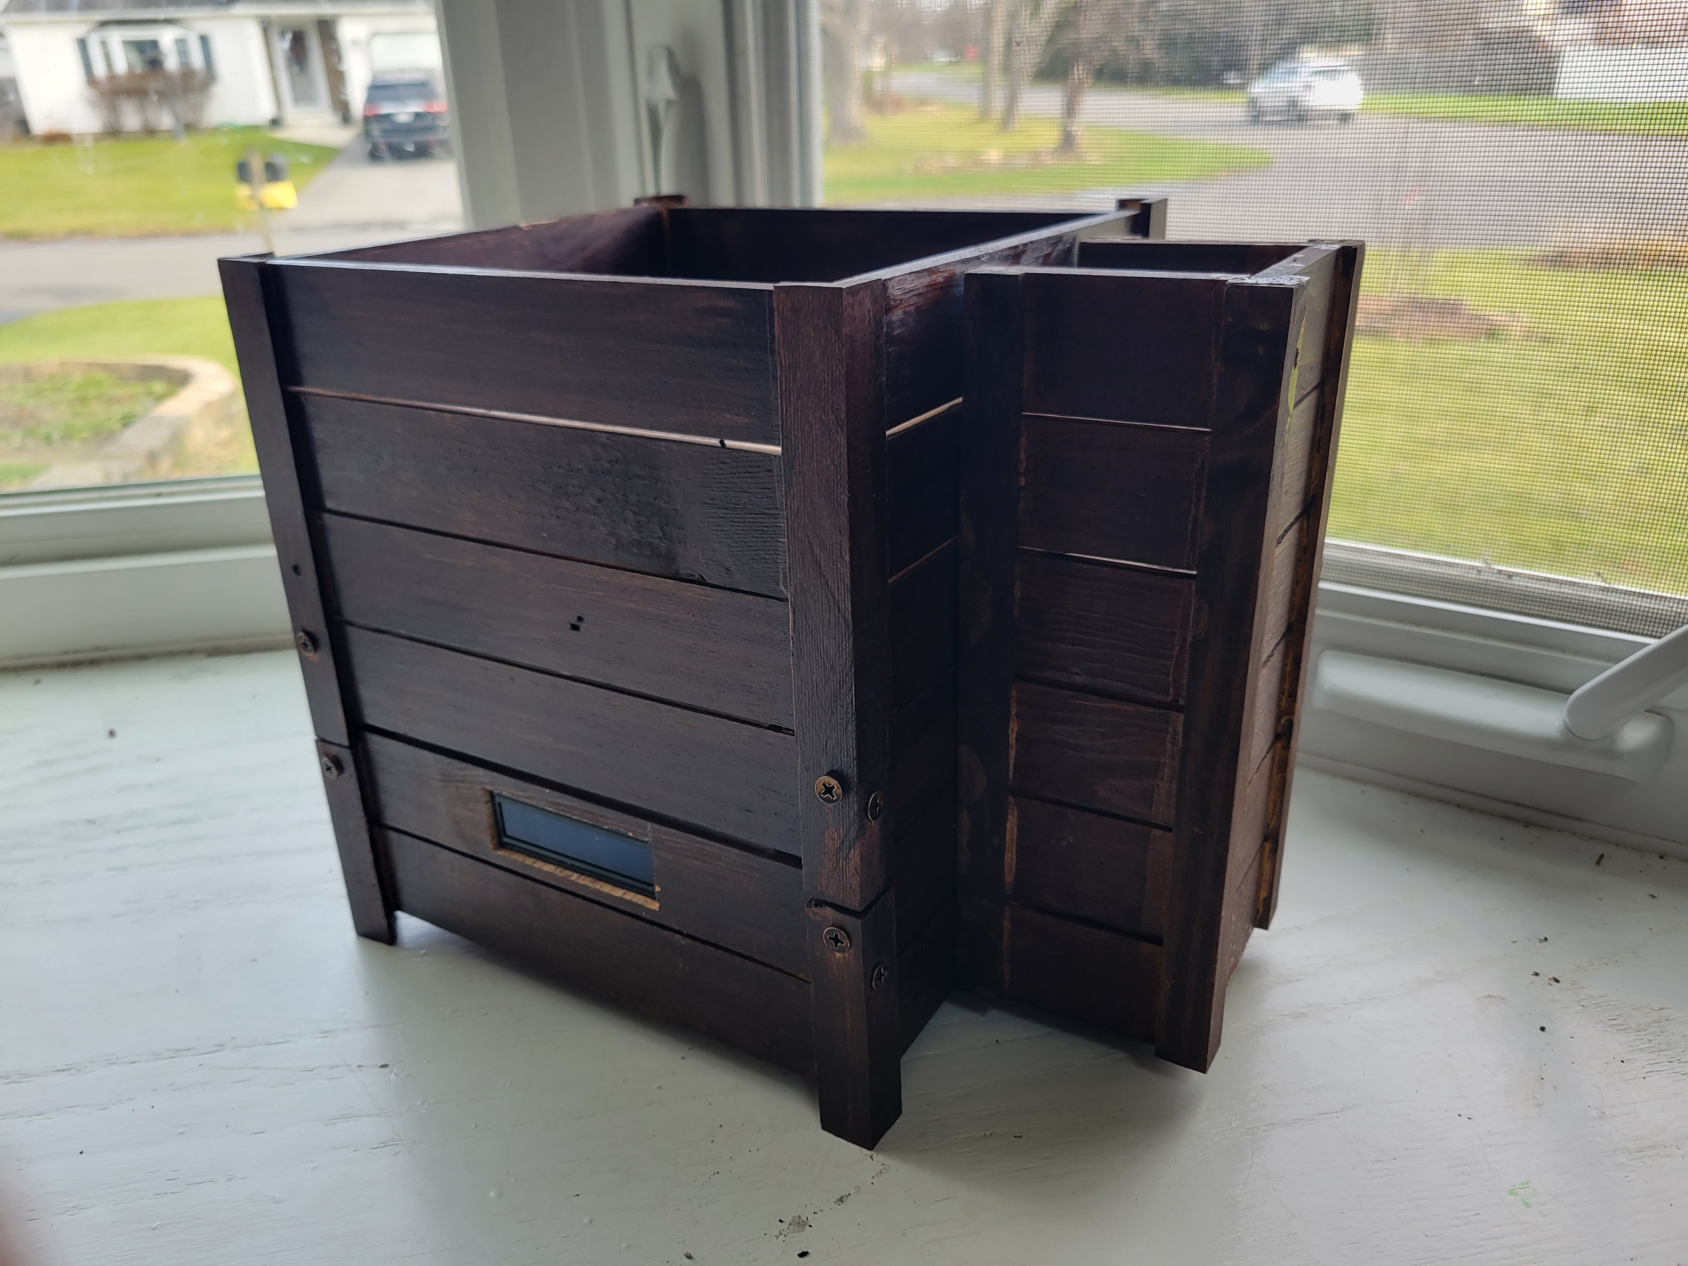

Slide 11
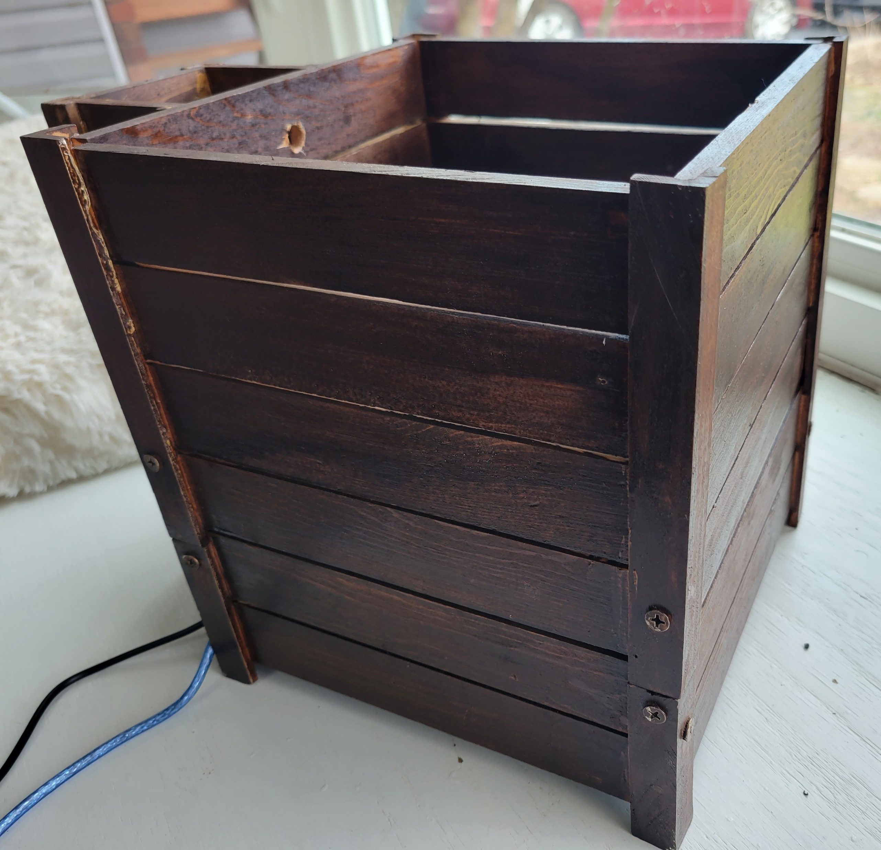
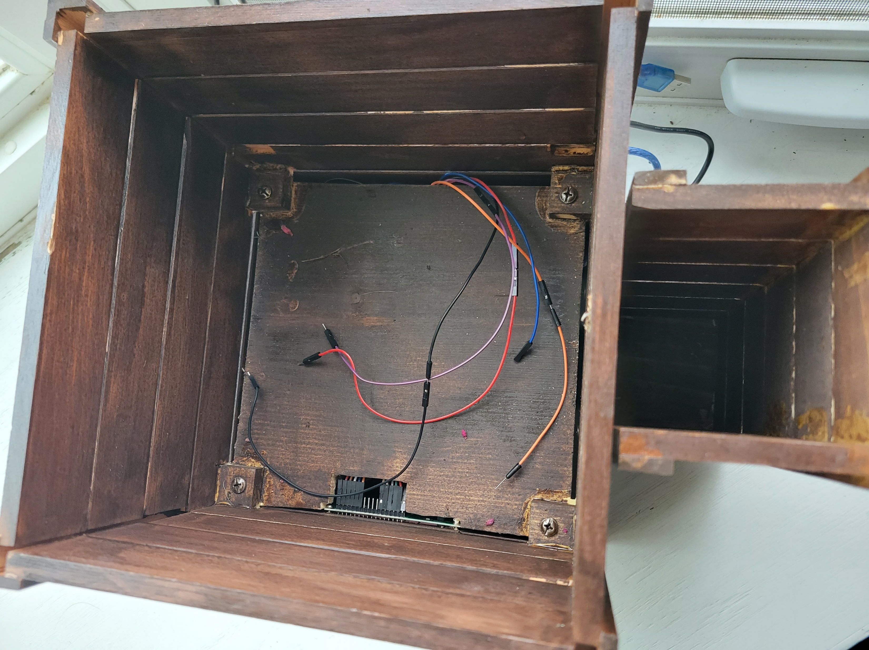

Slide 12
Enclosure & Components
Components

Slide 13
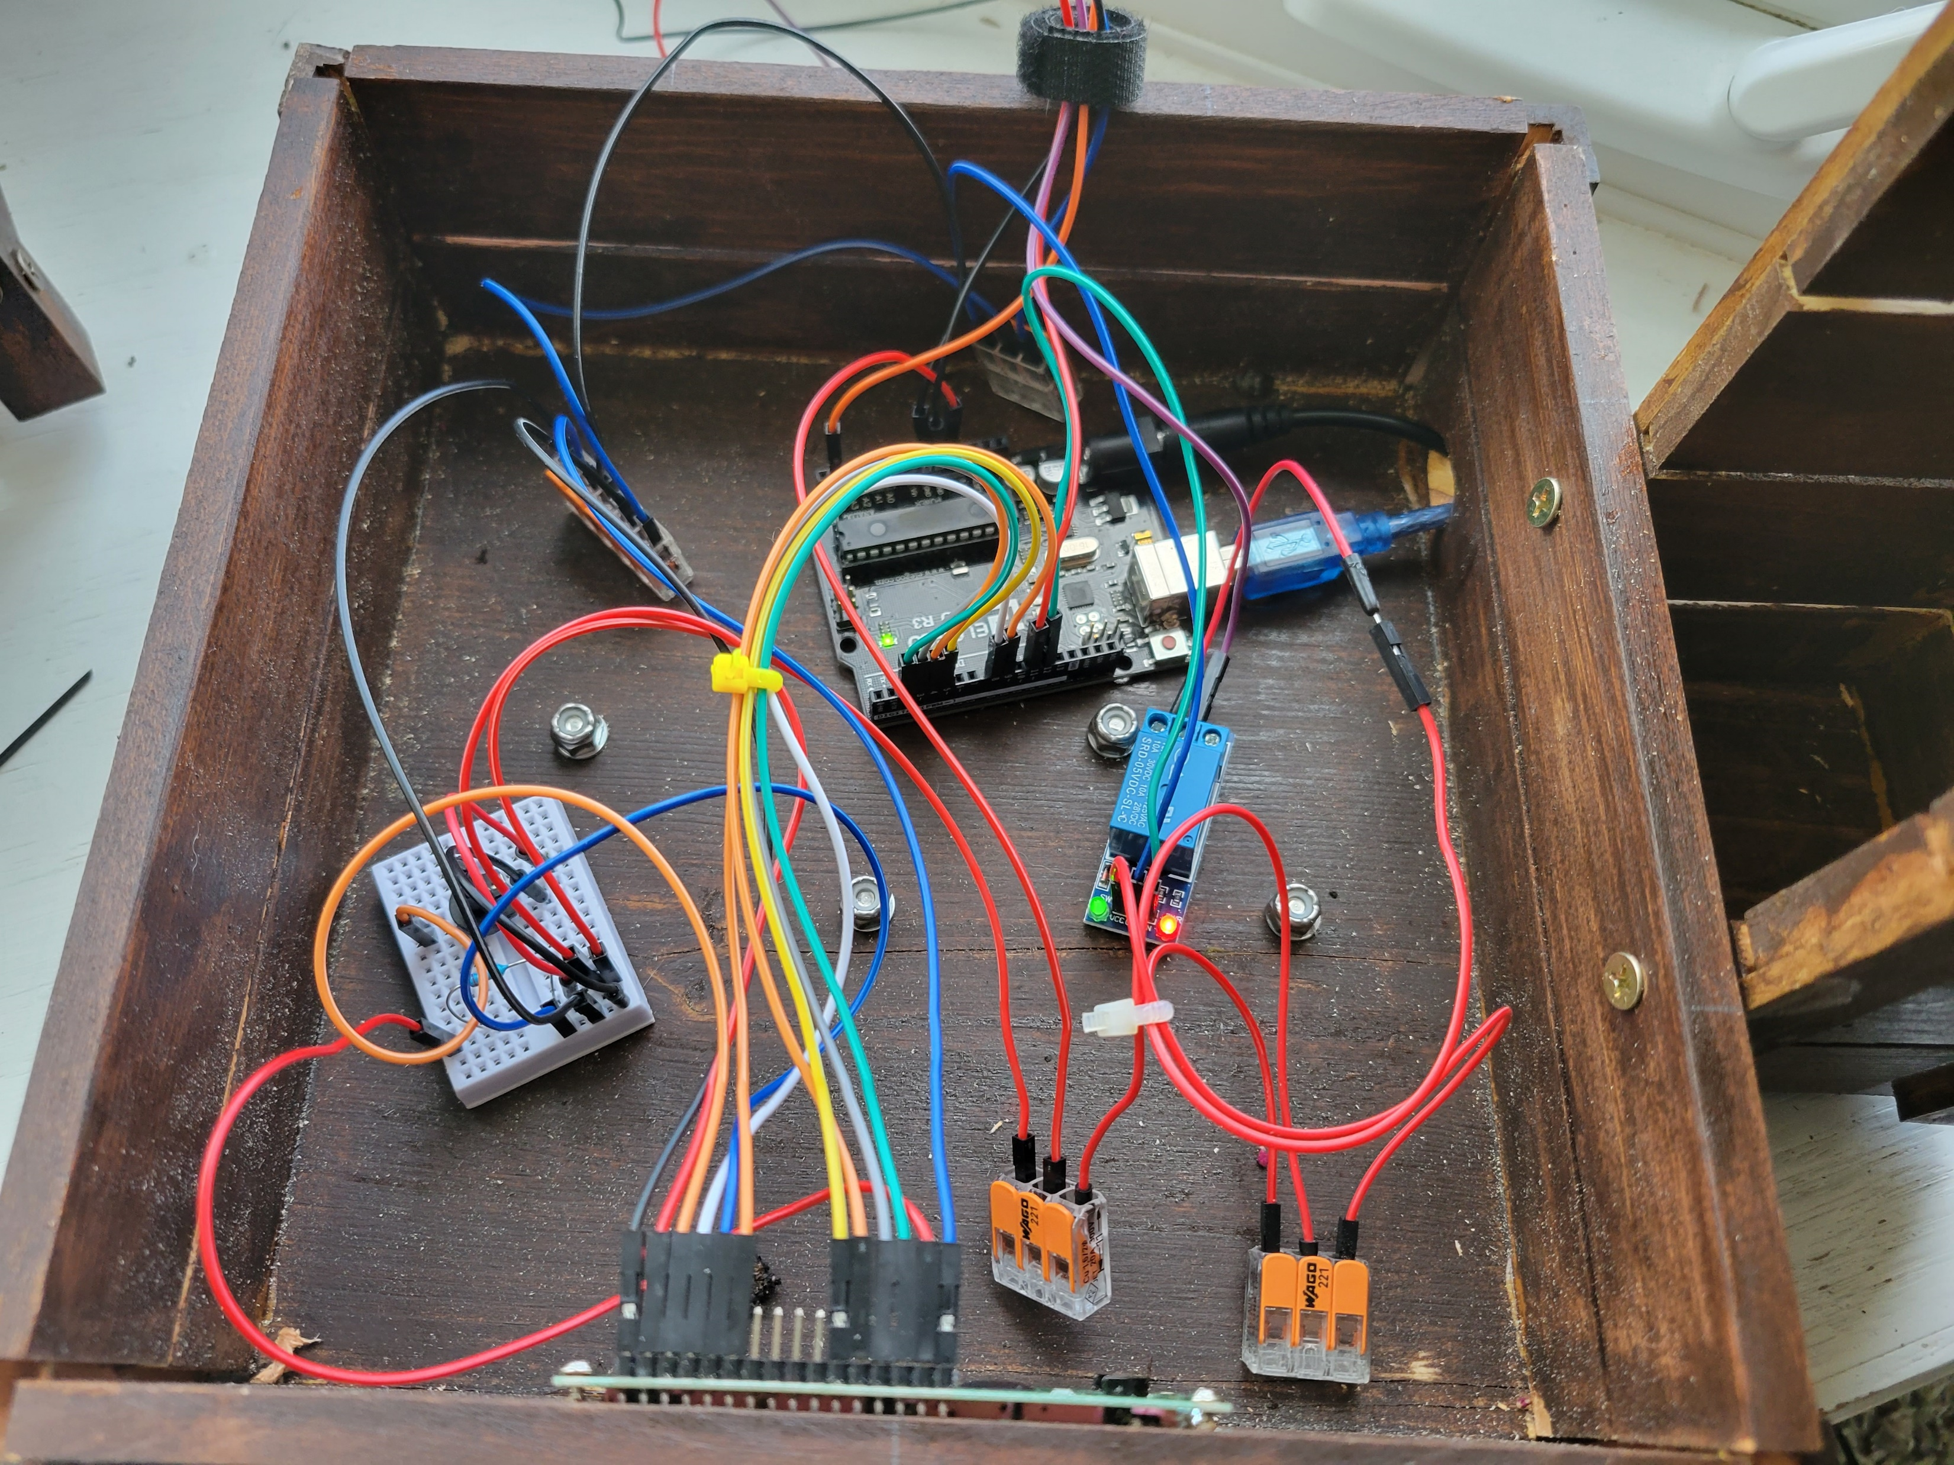
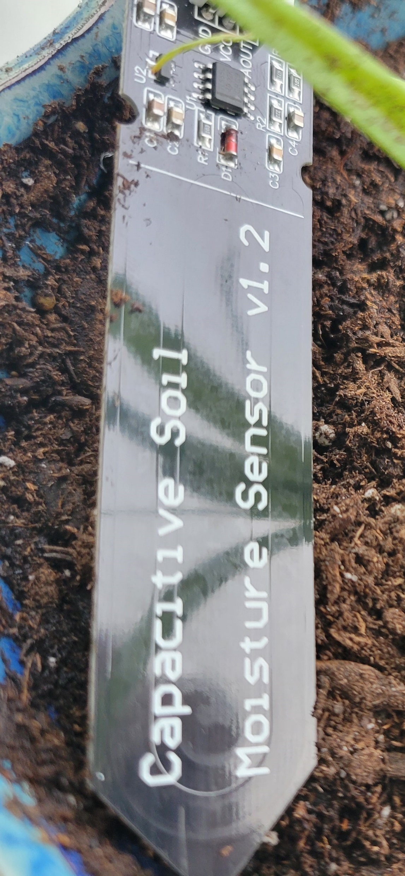

Slide 14
The Code

Slide 15
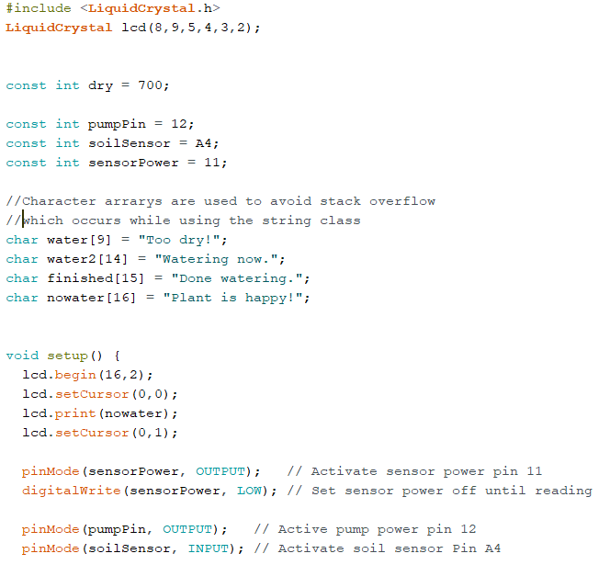
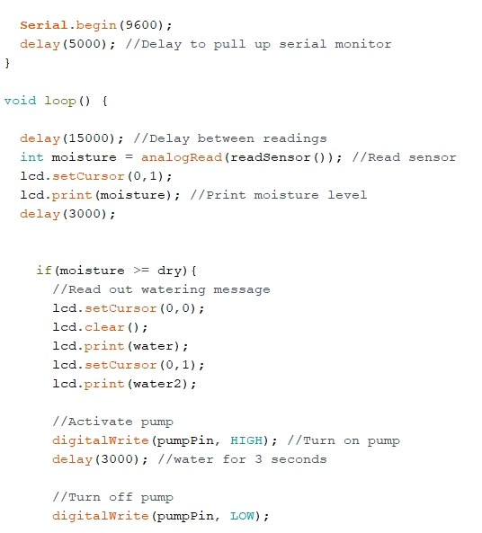

Slide 16
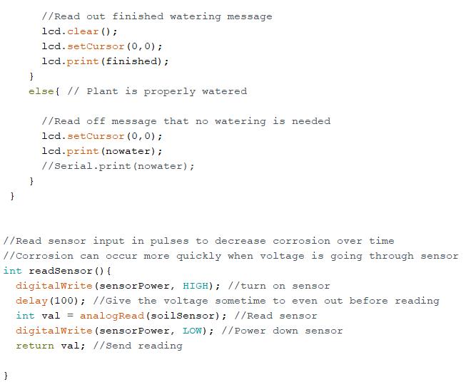

Slide 17
Final Product

Slide 18
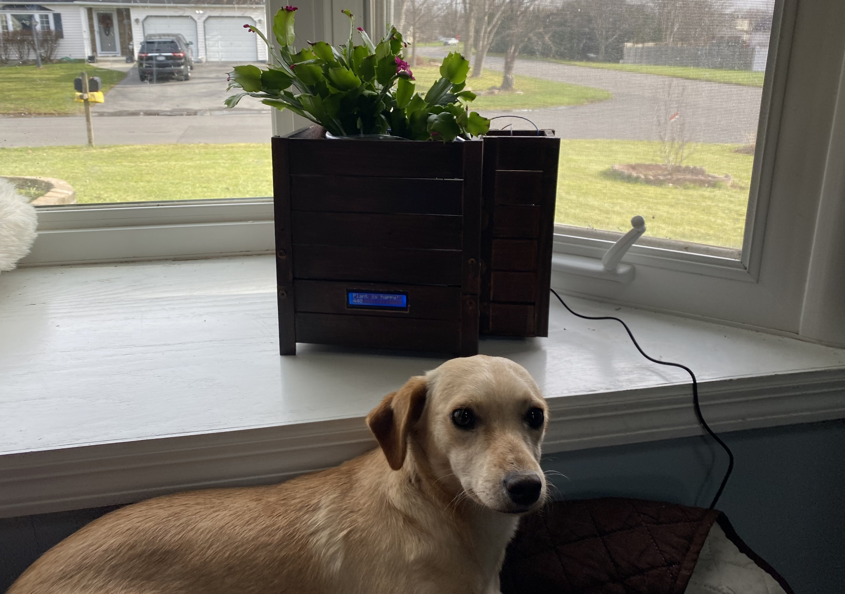

Slide 19
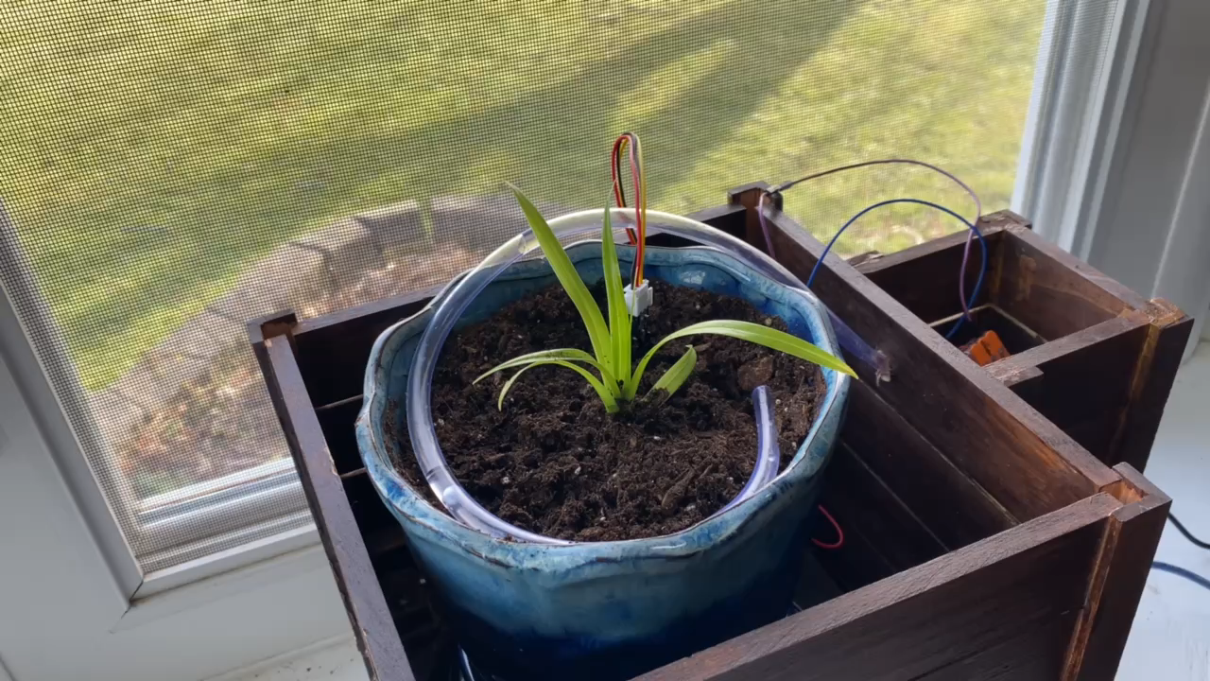

Slide 20
Conclusion
This project was enjoyable and had a good purpose for many small households. It can be used for a variety of plants with a small tweak depending on the water demand.
The box creation, LCD wiring and small tweaks in coding were the biggest issues to get past during this process. But now the product is largely independent and requires minimal maintenance.
It looks good and ugly wires can be hidden/ are minimal!
We would recommend this project for a personal challenge.

